Slide 1
Anomaly Detection
5/21

Slide 2
Outline
What is Anomaly Detection
Classic Method
With Classifier
GMM (Gaussian Mixture Model)
Auto-Encoder
PCA
Isolation Forest
Summary
Anomaly Detection on image
AnoGAN
EGBAD
GANomaly
Summary
Anomaly Detection on Audio
GMGAN

Slide 3
What is Anomaly Detection

Slide 4






What is Anomaly
Training Data
Anomaly
Anomaly

Slide 5
Classic Method

Slide 6
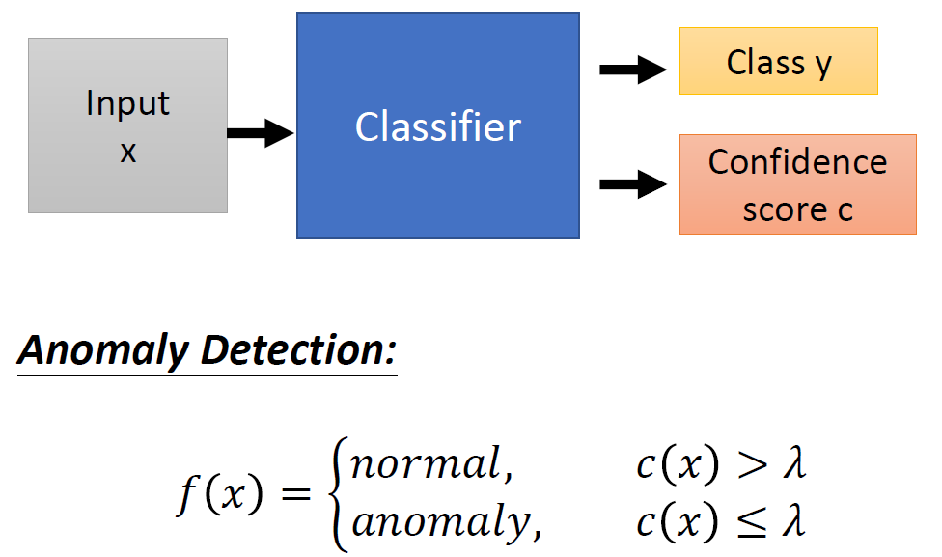
With Classifier

Slide 7
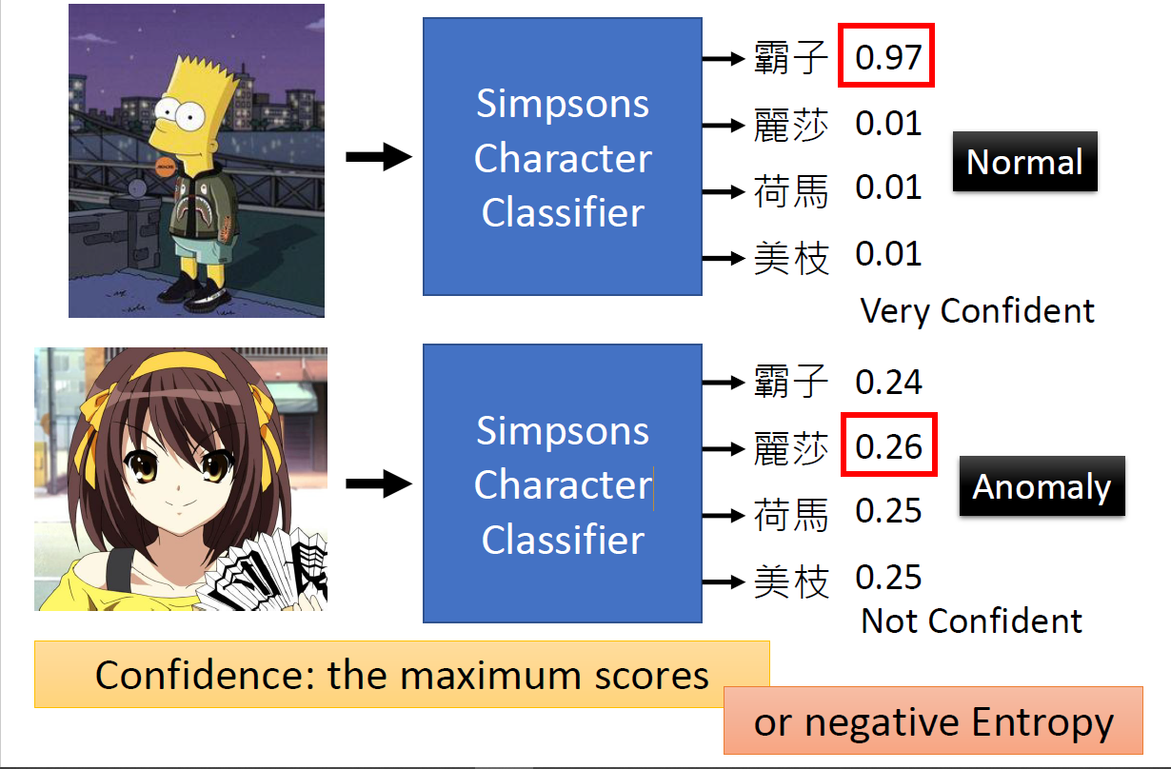
With Classifier

Slide 8
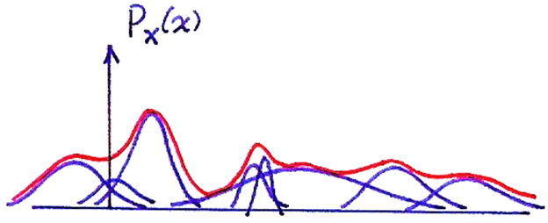
GMM (Gaussian Mixture Model)
1-dim Gaussian Mixtures
http://speech.ee.ntu.edu.tw/DSP2019Autumn/Slides/2.0.pptx

Slide 9
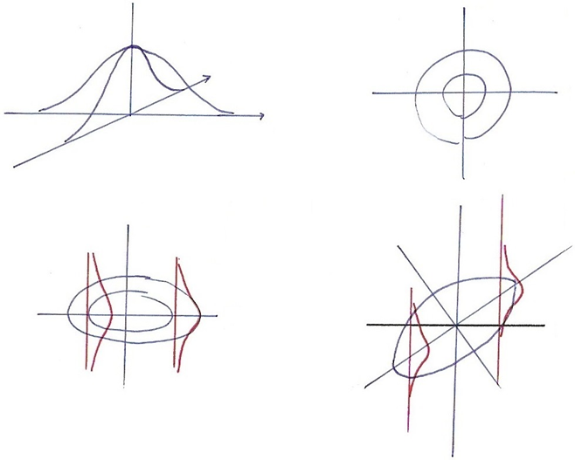
GMM (Gaussian Mixture Model)
2-dim Gaussian
http://speech.ee.ntu.edu.tw/DSP2019Autumn/Slides/2.0.pptx

Slide 10
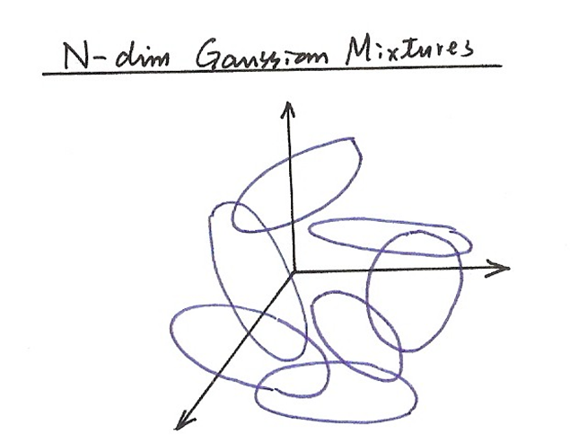
GMM (Gaussian Mixture Model)
N-dim Gaussian Mixtures
http://speech.ee.ntu.edu.tw/DSP2019Autumn/Slides/2.0.pptx

Slide 11
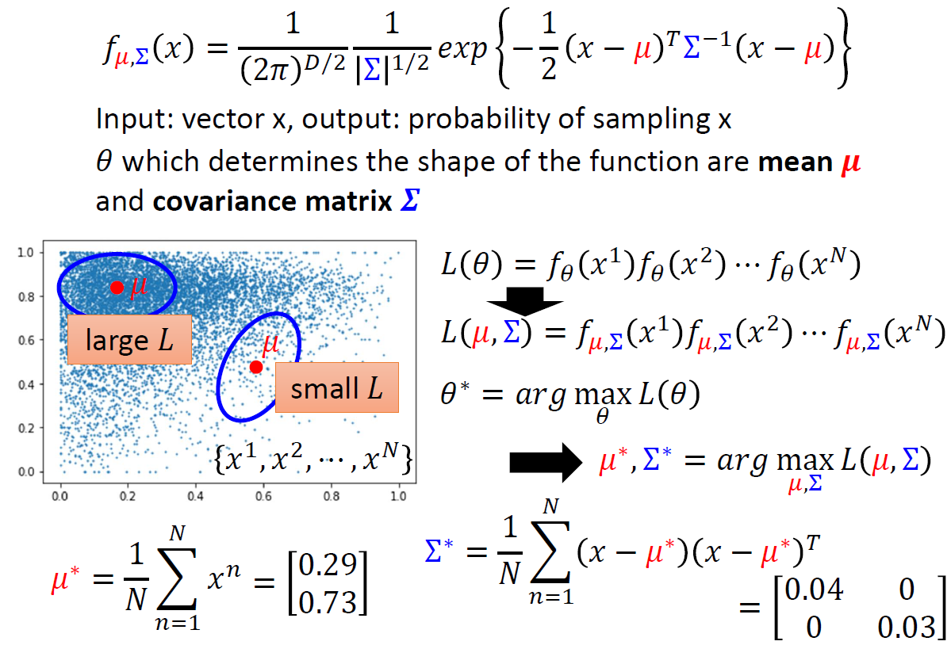
GMM (Gaussian Mixture Model)

Slide 12
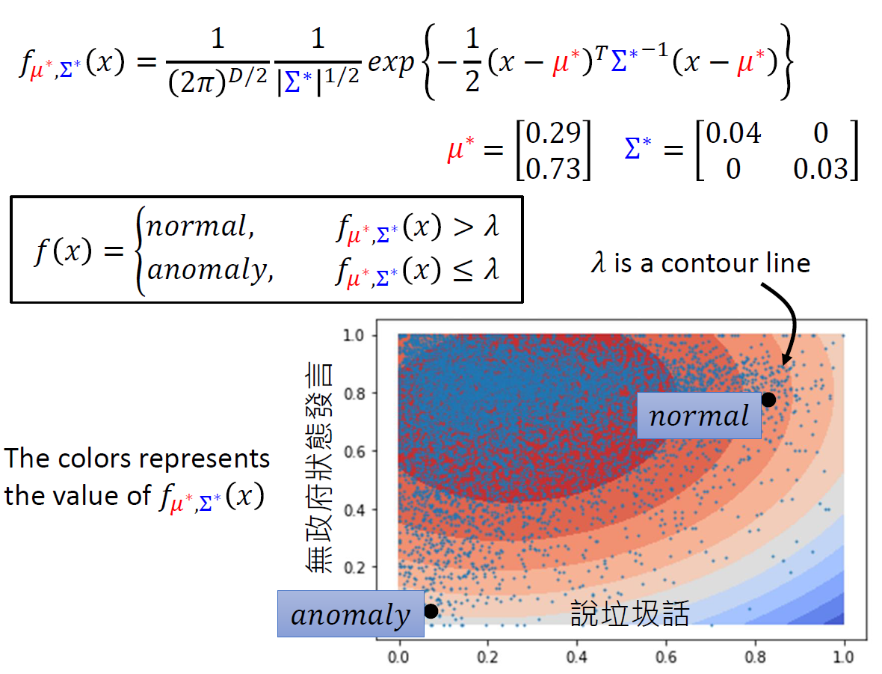
GMM (Gaussian Mixture Model)

Slide 13
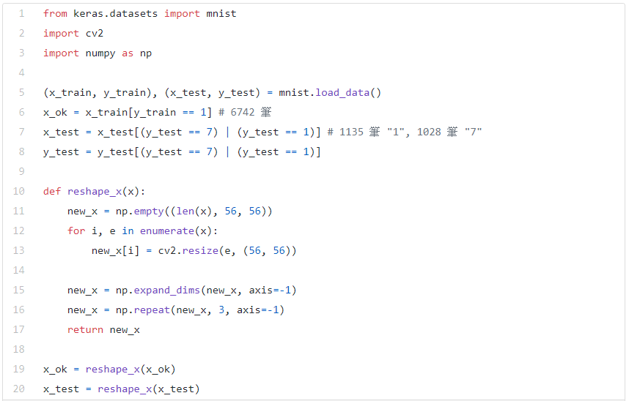
GMM (Gaussian Mixture Model)
https://towardsdatascience.com/a-simple-way-to-detect-anomaly-3d5a48c0dae0

Slide 14
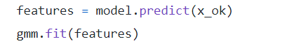
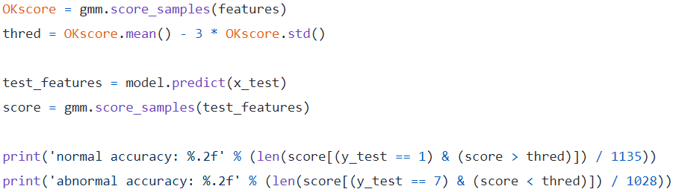
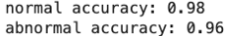
GMM (Gaussian Mixture Model)
https://towardsdatascience.com/a-simple-way-to-detect-anomaly-3d5a48c0dae0

Slide 15
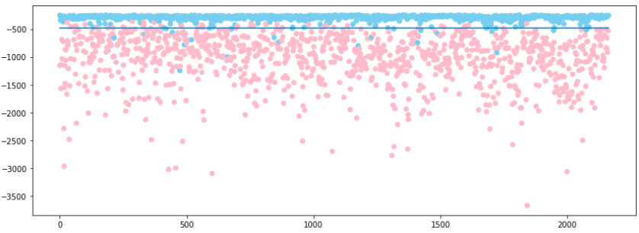
GMM (Gaussian Mixture Model)
https://towardsdatascience.com/a-simple-way-to-detect-anomaly-3d5a48c0dae0

Slide 16
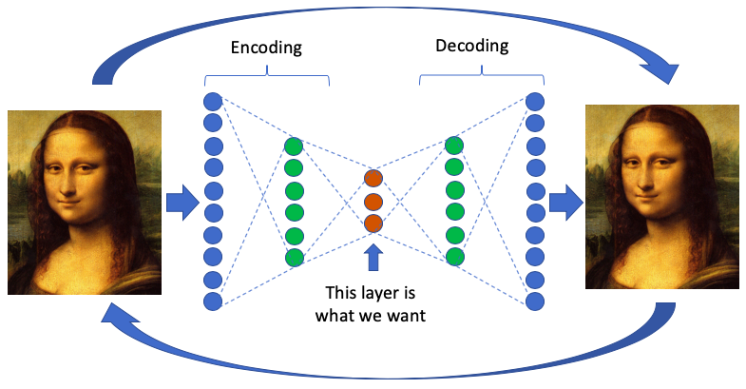
Auto-Encoder

Slide 17
Auto-Encoder
Examples:
https://www.kaggle.com/tikedameu/anomaly-detection-with-autoencoder-pytorch
https://towardsdatascience.com/anomaly-detection-with-autoencoder-b4cdce4866a6

Slide 18
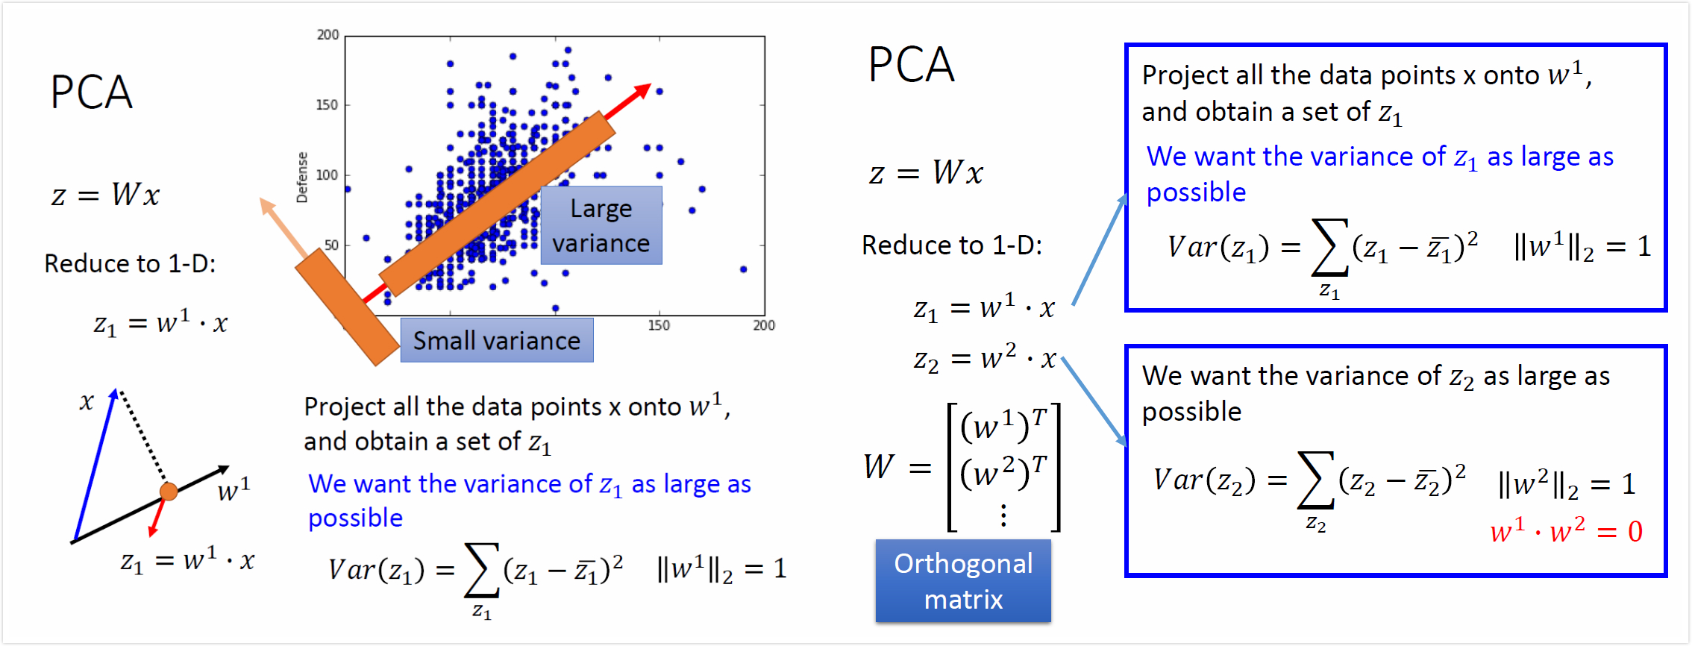
PCA
http://speech.ee.ntu.edu.tw/~tlkagk/courses/ML_2017/Lecture/PCA%20(v3).pdf

Slide 19
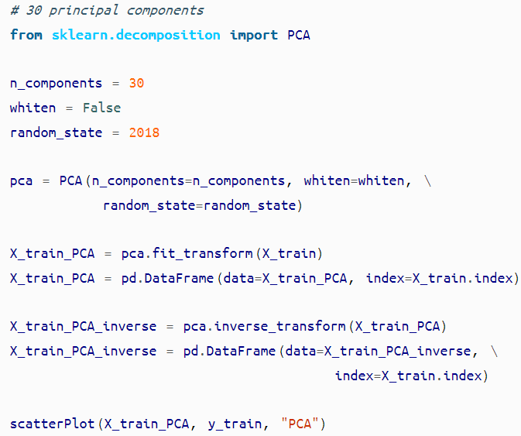
PCA
https://www.oreilly.com/library/view/hands-on-unsupervised-learning/9781492035633/ch04.html
Notes:
Data: credit card transactions
Train: 190,820 transactions and 330 cases of fraud
Test: 93,987 transactions and 162 cases of fraud

Slide 20
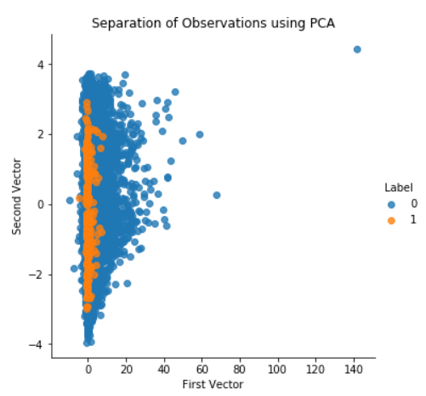
PCA
https://www.oreilly.com/library/view/hands-on-unsupervised-learning/9781492035633/ch04.html
Notes:
non fraud (normal) : 0
fraud (anomaly): 1

Slide 21
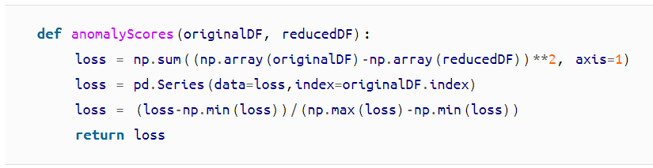
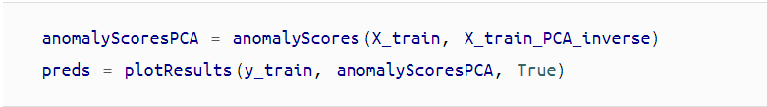
PCA
https://www.oreilly.com/library/view/hands-on-unsupervised-learning/9781492035633/ch04.html

Slide 22
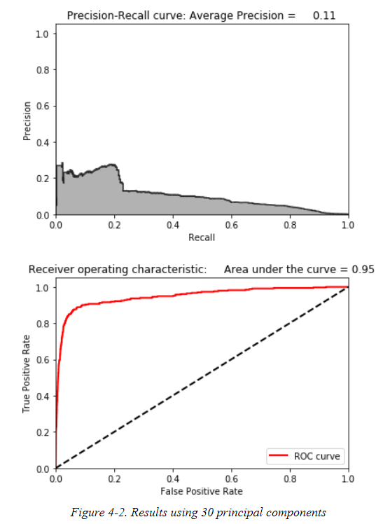
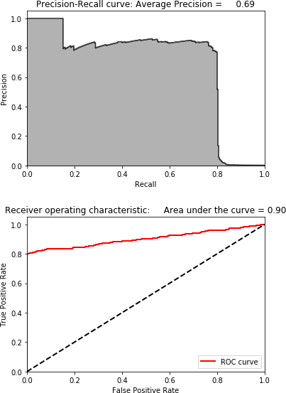
PCA
n_components = 30 n_components = 27
https://www.oreilly.com/library/view/hands-on-unsupervised-learning/9781492035633/ch04.html

Slide 23
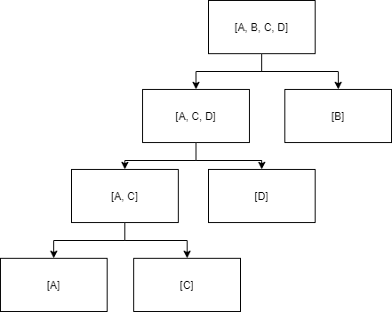
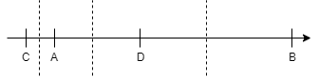
Isolation Forest
Use tree like structure to split data

Slide 24
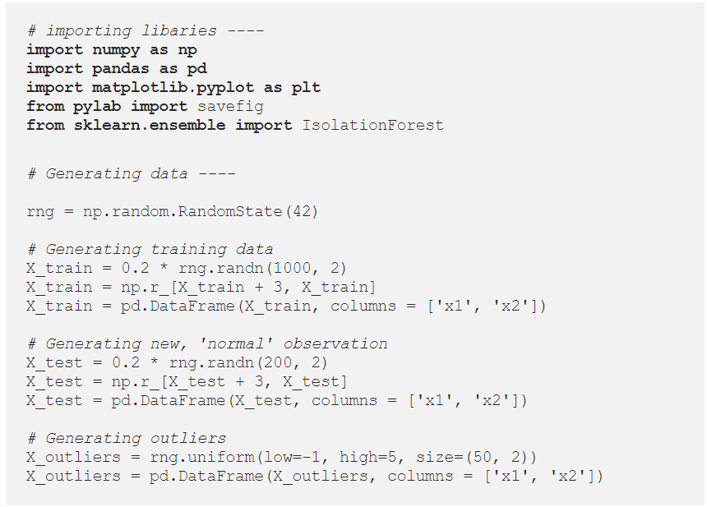
Isolation Forest
https://towardsdatascience.com/outlier-detection-with-isolation-forest-3d190448d45e

Slide 25
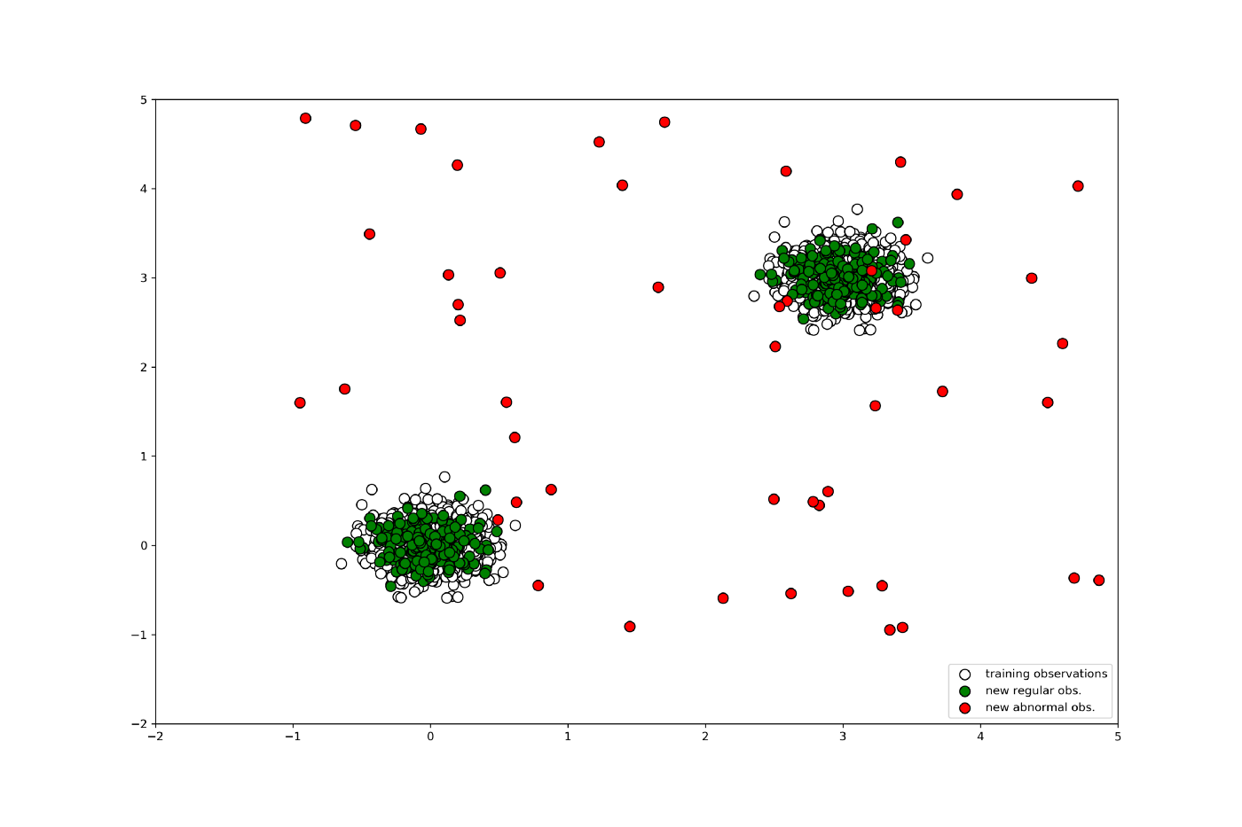
Isolation Forest
https://towardsdatascience.com/outlier-detection-with-isolation-forest-3d190448d45e

Slide 26
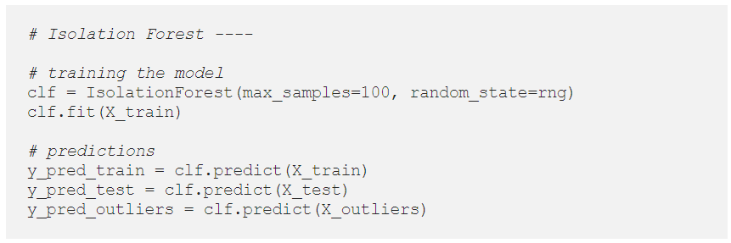
Isolation Forest
https://towardsdatascience.com/outlier-detection-with-isolation-forest-3d190448d45e

Slide 27
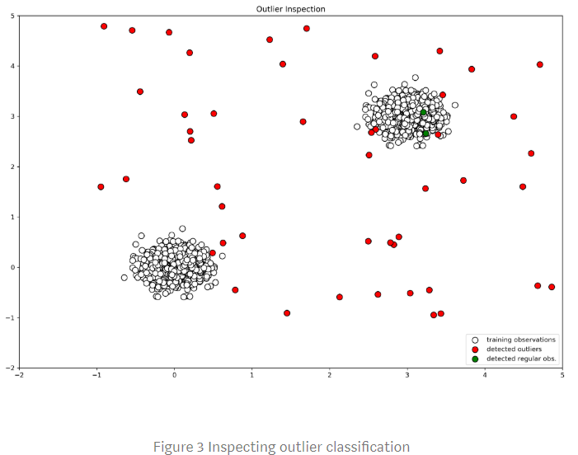
Isolation Forest
https://towardsdatascience.com/outlier-detection-with-isolation-forest-3d190448d45e

Slide 28
Summary of classic method
With Classifier
GMM (Gaussian Mixture Model)
Auto-Encoder
PCA
Isolation Forest

Slide 29
Anomaly detection on image

Slide 30
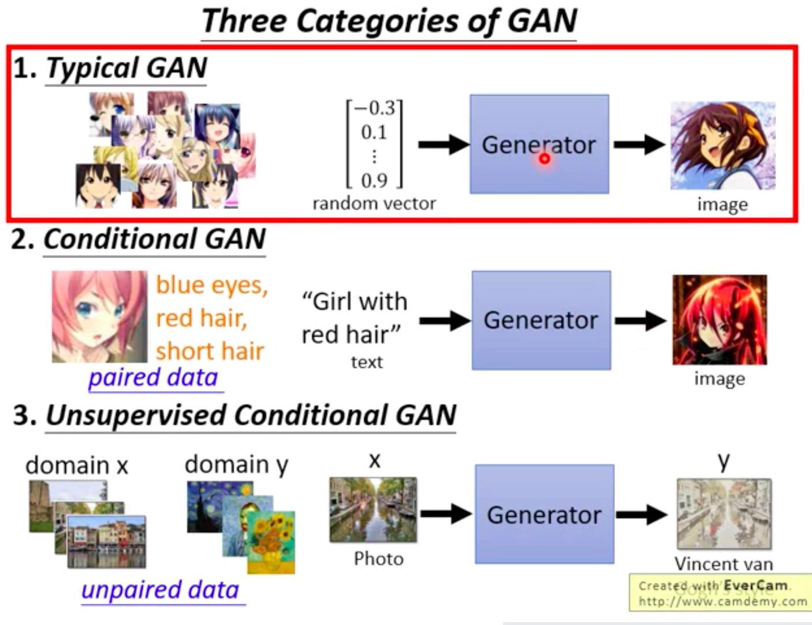
Typical GANs
http://speech.ee.ntu.edu.tw/~tlkagk/courses/MLDS_2018/Lecture/GAN%20(v2).pdf

Slide 31
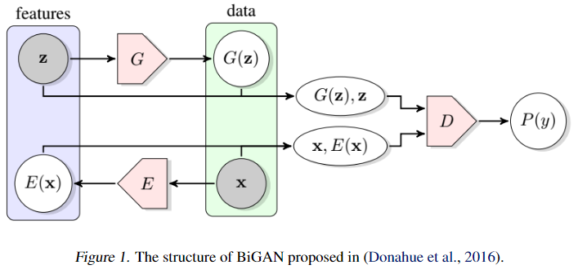
Typical GANs
https://arxiv.org/pdf/1906.11632.pdf

Slide 32
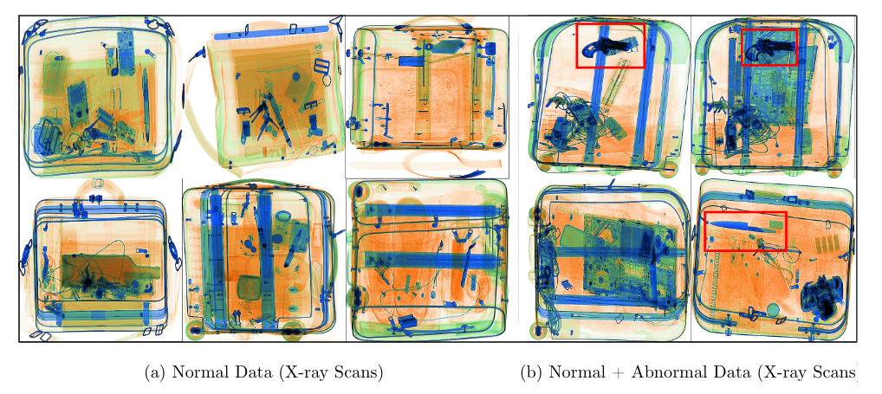
Example

Slide 33
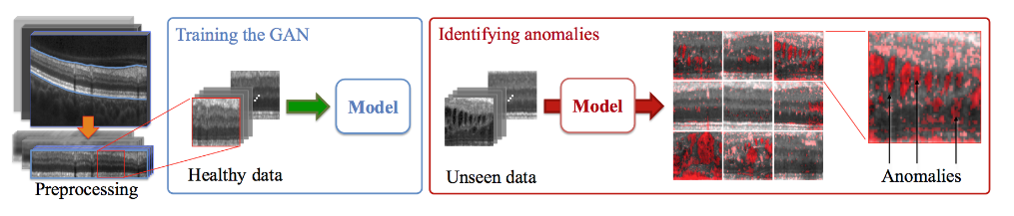
AnoGAN
Train a standard GAN only on positive samples
https://arxiv.org/pdf/1906.11632.pdf

Slide 34
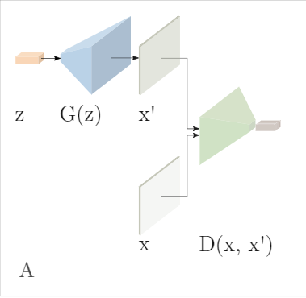
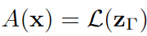
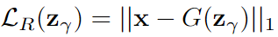
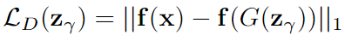
AnoGAN
Anomaly Score
for 𝛾 = 1, 2, … 𝜞 find proper z
https://arxiv.org/pdf/1905.13147.pdf

Slide 35
AnoGAN
Pros
Showed that GANs can be used for anomaly detection
Introduced a new mapping scheme from latent space to input data space.
Used the same mapping scheme to define an anomaly score.
Cons
Requires Γ optimization steps for every new input: bad test-time performance
The GAN objective has not been modified to take into account the need for the inverse mapping learning.
The anomaly score is difficult to interpret, not being in the probability range.
https://arxiv.org/pdf/1906.11632.pdf

Slide 36
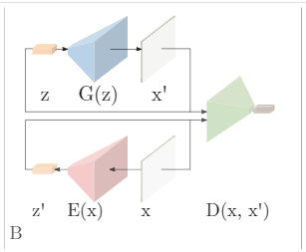
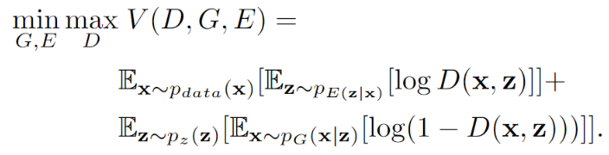
EGBAD (Efficient GAN-Based Anomaly Detection)
Train a Bi-GAN only on positive samples
https://arxiv.org/pdf/1906.11632.pdf

Slide 37
EGBAD (Efficient GAN-Based Anomaly Detection)
Pros
The Encoder E can learns how to encode image while adversarial training.
Therefore, it can bypass Γ optimization steps of AnoGAN while calculating anomaly score.

Slide 38
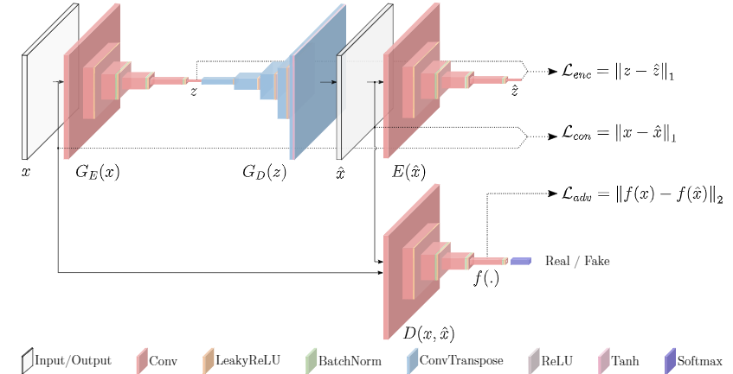
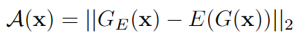
GANomaly
Generator is composed of encoder G_{E}, decoder G_{D}, and encoder E
Trained on only normal data.
Anomaly score
https://arxiv.org/pdf/1906.11632.pdf
https://arxiv.org/pdf/1905.13147.pdf

Slide 39
GANomaly
Pros
An encoder is learned during the training process, so it can bypass the Γ optimization.
Using an autoencoder like architecture (no use of noise prior) makes the entire learning process faster.
The contextual loss can be used to localize the anomaly.
Cons
Defines a new anomaly score.
It allows to detect anomalies both in the image space and in the latent space, but the results couldn’t match:
a higher anomaly score, that’s computed only in the latent space, can be associated with a generated sample with a low contextual loss value and thus very similar to the input - and vice versa.
https://arxiv.org/pdf/1906.11632.pdf

Slide 40
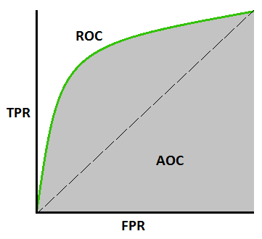
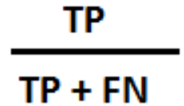
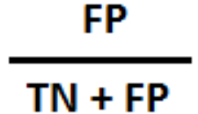
Evaluation Metric
TPR (True Positive Rate)
FPR (False Positive Rate)

Slide 41
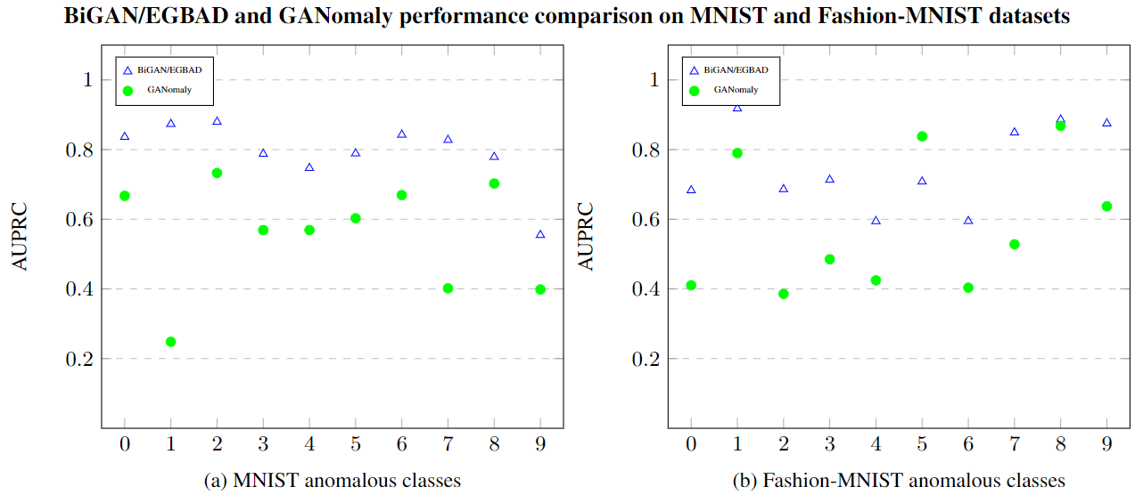
Comparison

Slide 42
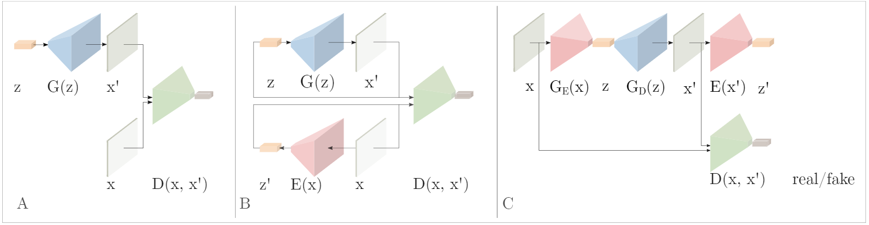
Summary of GANs
AnoGAN EGBAD GANomaly

Slide 43
Reference
https://arxiv.org/pdf/1711.09325.pdf
https://arxiv.org/pdf/1809.10816.pdf
https://arxiv.org/pdf/1812.02288.pdf
https://arxiv.org/pdf/1901.08954.pdf
https://arxiv.org/pdf/1905.13147.pdf

Slide 44
Anomaly detection on Audio

Slide 45
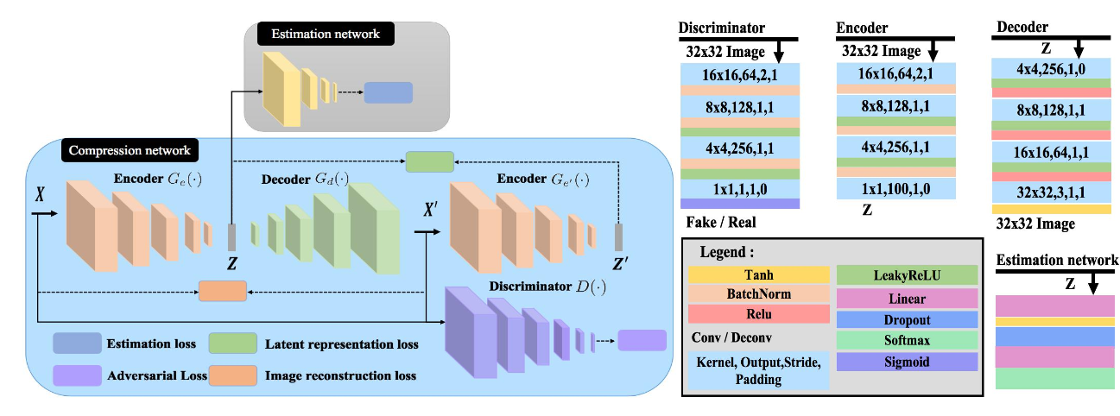
GMGAN (Gaussian Mixture GAN)
https://arxiv.org/pdf/2002.01107.pdf

Slide 46
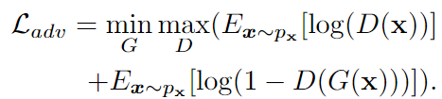
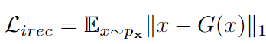
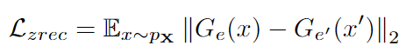
GMGAN (Gaussian Mixture GAN)
Adversarial loss
Image reconstruction loss
Latent representation loss
https://arxiv.org/pdf/2002.01107.pdf

Slide 47
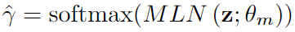
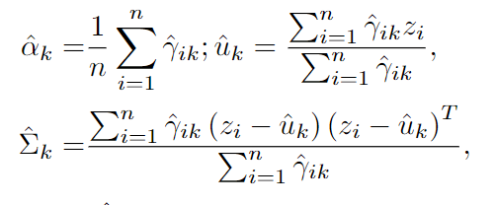
GMGAN (Gaussian Mixture GAN)
Estimation loss
is a K-dimensional vector and. denotes the input belongs to the k^{th} distribution.
Calculate the component of k^{th} mixture.
https://arxiv.org/pdf/2002.01107.pdf

Slide 48
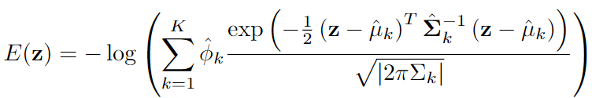

GMGAN (Gaussian Mixture GAN)
Estimation loss
https://arxiv.org/pdf/2002.01107.pdf

Slide 49

GMGAN (Gaussian Mixture GAN)
https://arxiv.org/pdf/2002.01107.pdf

Slide 50

GMGAN (Gaussian Mixture GAN)

Slide 51
Outline
What is Anomaly Detection
Classic Method
With Classifier
GMM (Gaussian Mixture Model)
Auto-Encoder
PCA
Isolation Forest
Summary
Anomaly Detection with GAN
AnoGAN
EGBAD
GANomaly
Summary
Anomaly Detection on Audio
GMGAN

Slide 52
More Reference
Anomaly detection on self-driving
http://taoxie.cs.illinois.edu/publications/tii17-safedrive.pdf
https://arxiv.org/pdf/2004.09496.pdf
https://arxiv.org/pdf/2004.12581.pdf

